Slide 1
Neural Artistic Style
By:
DEEPAK KUMAR, EKANSH GUPTA, PRAMOD GHUGE
(15095026) (15095028) (15095029)
Electronics Engineering Under the guidance of:
IIT (BHU) Varanasi Dr. R. DWIVEDI

Slide 2
ABSTRACT
The Neural Style Algorithm synthesizes a pastiche by separating and combining the content of one image with the style of another image using convolutional neural network (CNN). We are working on an algorithm that would separate and recombine the image content and style of natural images.

Slide 3
METHODOLOGY
Transferring the style from one image onto another can be considered a problem of texture transfer. In texture transfer the goal is to synthesize a texture from a source image while constraining the texture synthesis in order to preserve the semantic content of a target image.
The recent advance of Deep Convolutional Neural Networks has produced powerful computer vision systems that learn to extract high-level semantic information from natural images.

Slide 4
METHODOLOGY
Convolutional neural networks (CNN):
They are primarily used for image processing but can also be used for other types of input such as audio. A typical use case for CNNs is where you feed the network images and the network classifies the data, e.g. it outputs “cat” if you give it a cat picture and “dog” when you give it a dog picture. CNNs tend to start with an input “scanner” which is not intended to parse all the training data at once.

Slide 5
METHODOLOGY
The input data is fed through convolutional layers instead of normal layers, where not all nodes are connected to all nodes. Each node only concerns itself with close neighboring cells. Besides these convolutional layers, they also often feature pooling layers. Pooling is a way to filter out details.

Slide 6
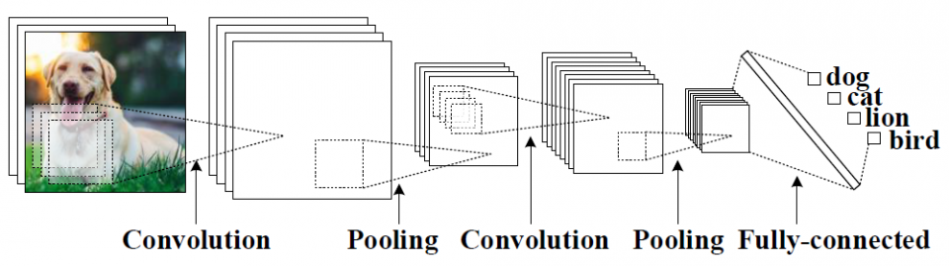
METHODOLOGY
An example of CNN architecture.
Source: Google

Slide 7
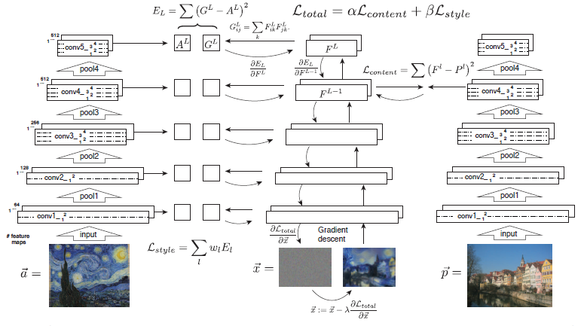
METHODOLOGY
Style Transfer Algorithm:

Slide 8
METHODOLOGY
Style Transfer Algorithm:
First content and style features are extracted and stored. The style image a is passed through the network and its style representation A^{l} on all layers included are computed and stored. The content image p is passed through the network and the content representation P^{l} in one layer is stored. Then a random white noise image x is passed through the network and its style features G^{l} and content features F^{l} are computed. On each layer included in the style representation, the element-wise mean squared difference between G^{l} and A^{l} is computed to give the style loss L_{style}.

Slide 9
METHODOLOGY
Style Transfer Algorithm:
Also the mean squared difference between F^{l} and P^{l} is
computed to give the content loss L_{content}. The total loss L_{total} is then a linear combination between the content and the style loss. Its derivative with respect to the pixel values can be computed using error back-propagation. This gradient is used to iteratively update the image x until it simultaneously matches the style features of the style image a and the content features of the content image p.

Slide 10
References
Image Style Transfer Using Convolutional Neural Networks by Leon A. Gatys, Alexander S. Ecker, Matthias Bethge

